Slide 1
JAVA

Slide 2
Agenda
Classes and methods
Access Modifiers
Overloading
Arrays and collections
Further readings

Slide 3
Classes and methods
The class is at the core of Java, and the most important thing to understand about a class is that it defines a new data type.
An object is an instance of a class.
class classname {
type instance-variable1;
type instance-variable2;
// ...
type instance-variableN;
type methodname1(parameter-list) {
// body of method
}
// ...
type methodnameN(parameter-list) {
// body of method
}
}

Slide 4
Example
/* A program that uses the Box class.
Call this file Box.java
*/
class Box {
double width;
double height;
double depth;
}
// This class declares an object of type Box.
class BoxDemo {
public static void main(String args[]) {
Box mybox = new Box();
double vol;
// assign values to mybox's instance variables
mybox.width = 10;
mybox.height = 20;
mybox.depth = 15;
// compute volume of box
vol = mybox.width * mybox.height * mybox.depth;
System.out.println("Volume is " + vol);
}
}

Slide 5
Example 02:
public class Rectangle {
float length;
float breadth;
// constructor
Rectangle(float length, float breadth) {
this.length = length;
this.breadth = breadth;
}
// method to return Area of rectangle
public float getAreaOfRectangle() {
return length * breadth;
}
public static void main(String args[]) {
Rectangle rectangle = new Rectangle(10, 10);
System.out.println(rectangle.getAreaOfRectangle());
}
}

Slide 6
method
Syntax:
type name(parameter-list) {
// body of method
}
type: type of data returned by the method
name: name of the method
parameter-list: sequence of type and identifier pairs separated by commas

Slide 7
Example
class Box {
double width;
double height;
double depth;
// compute and return volume
double volume() {
return width * height * depth;
}
}

Slide 8
Overloading
Overloading :
The process to define two or more methods within the same class that share the same name, as long as their parameter declarations are different. (polymorphism)
EX:
public class Calculate {
public int sum(int a, int b) {
return a + b;
}
// Overload sum for parameter type float
public float sum(float a, float b) {
return a + b;
}
// Overload sum for 3 int parameters.
public int sum(int a, int b, int c) {
return a + b + c;
}…

Slide 9
Access Modifiers
default : Visible to the package. No modifiers are needed.
private : Visible to the class only.
public : Visible to the world.
protected : Visible to the package and all subclasses.

Slide 10
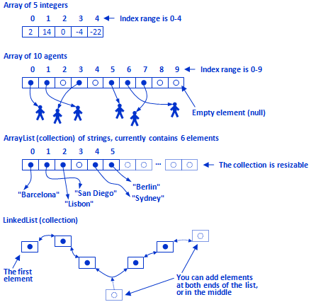
Arrays and collections
Arrays are fixed size and of same type of objects/primitive types.
Collections are resizable and contain only object type data.
Collection cannot store primitive types

Slide 11
Example
// This program demonstrates the length array member.
class Length {
public static void main(String args[]) {
int a1[] = new int[10];
int a2[] = {3, 5, 7, 1, 8, 99, 44, -10};
int a3[] = {4, 3, 2, 1};
System.out.println("length of a1 is " + a1.length);
System.out.println("length of a2 is " + a2.length);
System.out.println("length of a3 is " + a3.length);
}
}

Slide 12
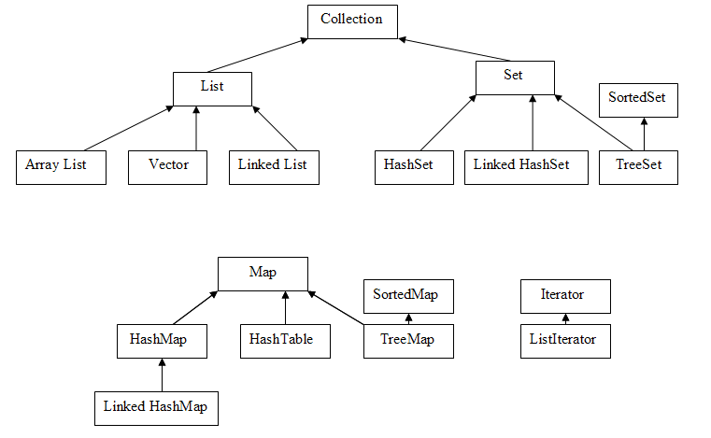

Slide 13
Further readings
You can go through the details of below topics.
Inheritance
Overriding
Interfaces
Collection
Exception Handling

Slide 14
References
https://docs.oracle.com/javase/tutorial/java/
http://www.java-examples.com/
Java The Complete Reference, 9th Edition.

Slide 15
Up next
Selenium web driver
Introduction and usage
Selenium with TestNG…
Maven
Introduction to maven
Selenium with maven project

